Slide 1
Counter emf starter
In this starter, voltage relays are connected across the armature and set to operate at successively increasing values of emf to cut out the starting resistance in steps.
The starting time is thus load-dependent.

Slide 2
Counter emf starter cont’d
On rising voltage, the voltage relays close relatively slowly and the contacts tend to weld in if this method is used for motors exceeding 5 hp.
The emf for which the contacts open is less than that at which they close so to restart a motor it should be allowed to slow down sufficiently for the emf to fall below the opening level.

Slide 3
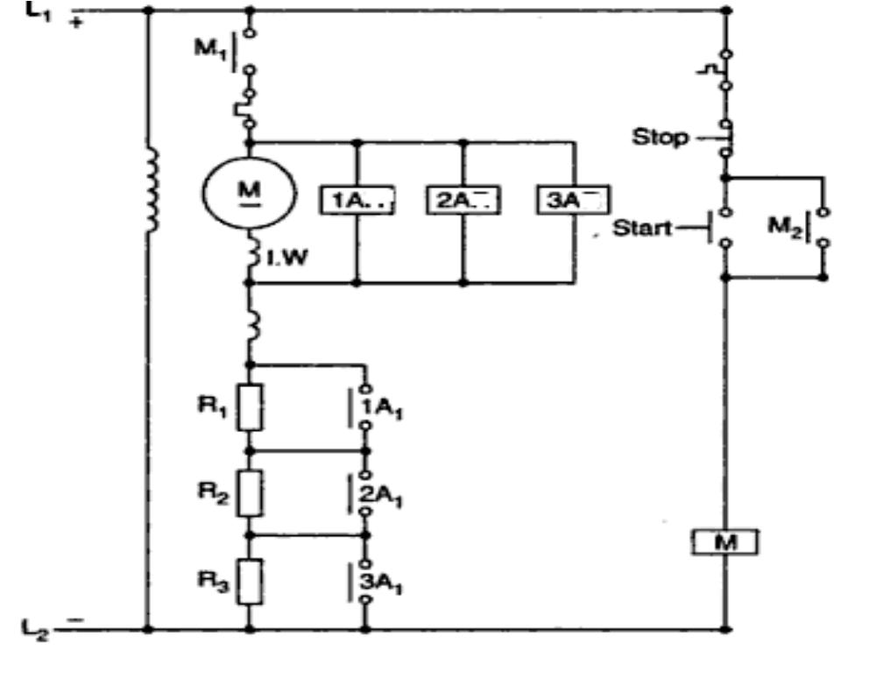

Slide 4
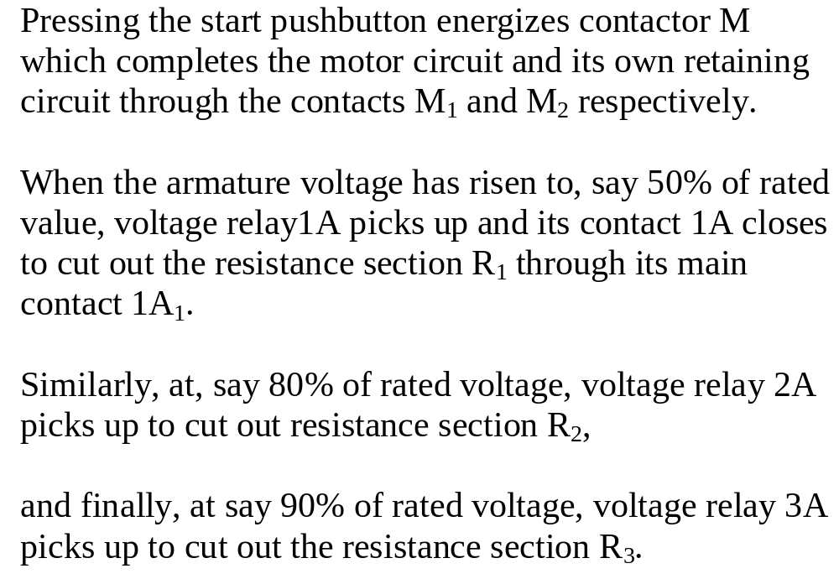

Slide 5
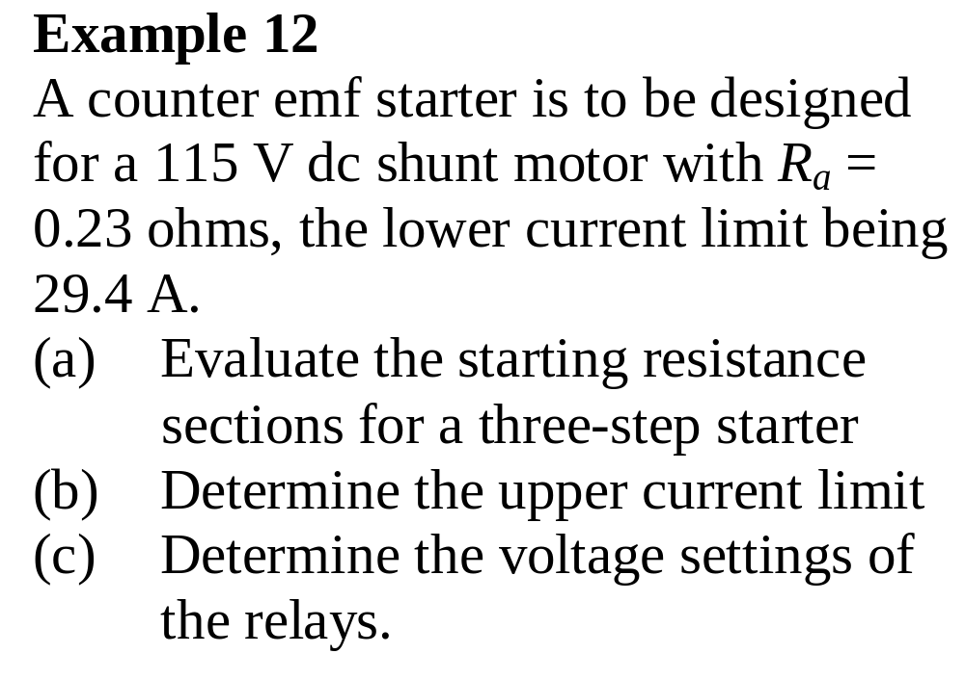

Slide 6
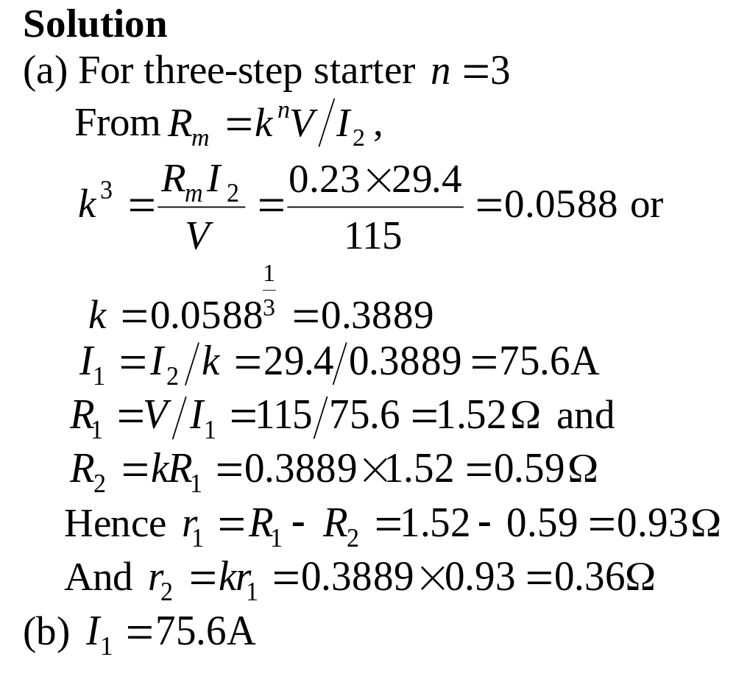

Slide 7
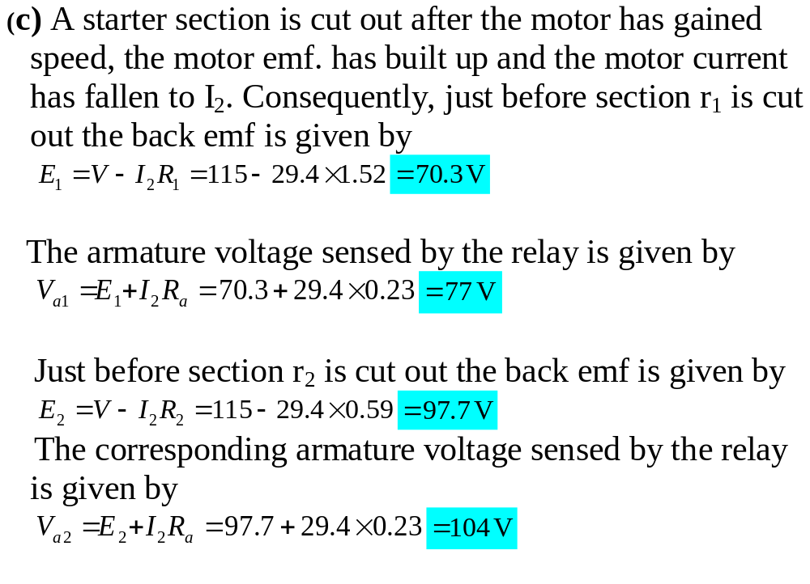

Slide 8
Definite-time starters
The relays are set to operate at prefixed intervals after the start is initiated.
The disadvantage of this type of starter is that the starting time is independent of the motor load.
Despite this disadvantage, they are more widely used than the current-limit starters. Why?

Slide 9
Definite-time starters cont’d
The fixed starting time make them useful where a driven machine must always repeat the same cycle of operation in manufacturing process
Or where several motors in a system must perform in a given time sequence.
The delays are timed so that the current does not fall below a lower current limit with the heaviest prospective load.

Slide 10
Definite-time starters cont’d
Consequently, on light loads the starting time is likely to be excessive.
The timing devices used to establish the required time delays may be pneumatic timers, motor-driven timers, electronic timers, dashpot relay timers, time delay contactors and others.

Slide 11
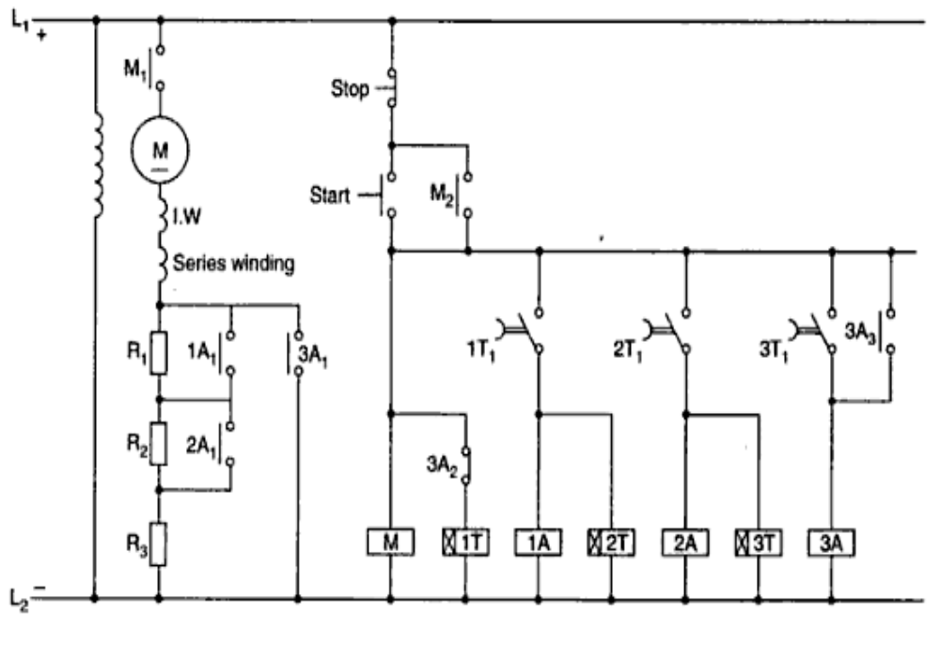

Slide 12
Definite-time starters cont’d
The timing device may be pneumatic timers, electronic timers or dashpot relay timers.
When the start pushbutton is pressed, the main contactor M and the timer 1T are energized and they get hold through contact M₂.
The timer 1T operates after a preset delay to energize contactor 1A through its delayed contact 1T₁.

Slide 13
Definite-time starters cont’d
The contactor 1A picks up and short-circuits the R₁ section of the starting resistance.
The timer 2T is energized at the same time as the contactor 1A, and after a preset time it similarly energizes contactor 2A to get the R₂ section of the starting resistance cut out.

Slide 14
Definite-time starters cont’d
Finally, just as previously discussed, timer 3T energizes contactor 3A to get the last section of the starting resistance short-circuited.
When contactor 3A picks up, it completes its retaining circuit through its NO contact 3A₃ and de-energizes contactors 1A and 2A and the timers through its NC contact 3A₂.

